Slide 1
CSE5095-002: Topics in Software Defined Networking
Lecture 3
Minmei Wang
Computer Science and Engineering
Slides source: Kurose and Ross, Chen Qian

Slide 2
History: the road to SDN

Slide 3
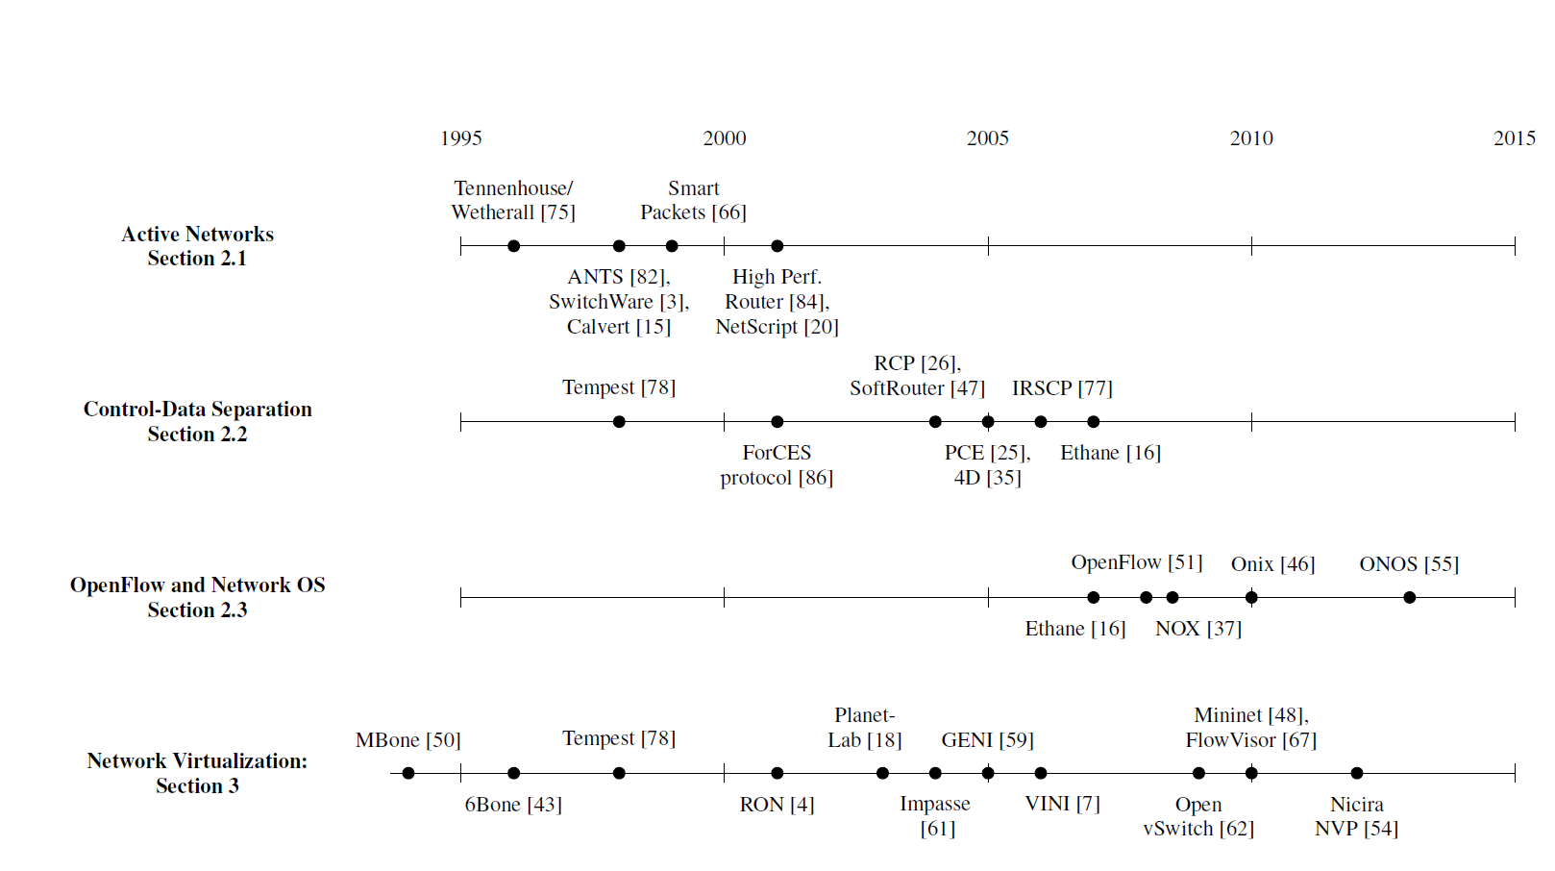
Selected developments
2014
Programmable data planes on programmable switches

Slide 4
Active networks
It is slow and difficult for researchers to add new protocols to the Internet
Protocol standardization by the IETF (Internet Engineering Task Force)
Manually deployment
Active networking
A radical approach to network control
Provide a programmable interface
Expose resource
Support the construction of custom functionality
Two programming models
Capsule model
Programming router/switch model

Slide 5
Active networks
ANTS: A toolkit for Building and Dynamically Deploying Network Protocols
David J. Wetherall, John V. Guttag and David L. Tennenhouse

Slide 6
ANTS
A new approach to automatically upgrade or deploy functionality of multiple protocols
New protocols can be dynamically deployed at routers and end systems
Three key components
Capsules
The required processing
Active nodes
The nodes that execute capsule processing routines and maintain states
Code distribution mechanism
Processing routines are automatically and dynamically transferred to target nodes

Slide 7
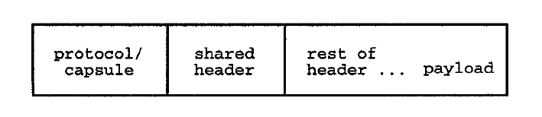
ANTS
Capsule format
Node primitives
Environment access
Node location, state of links, routing tables, local time, etc.
Capsule manipulation
Access to header fields and payload
Control operation
Create other capsules and forward, copy, discard
Node storage
A soft-store of application-defined objects held in a short interval
When a capsule arrives at a node, the node will execute its associated processing routine

Slide 8
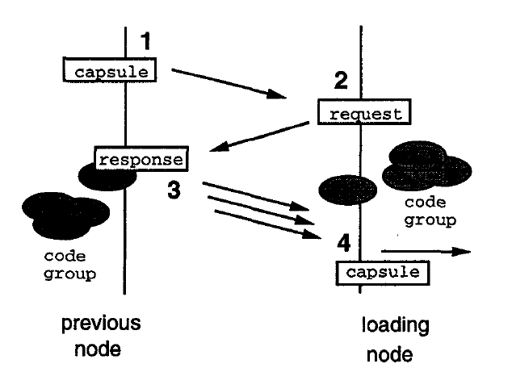
ANTS
Code distribution scheme
Requirements
Efficiency
Adapt to changes of node connectivity
Limit its activity – robustness
Couple the transfer of code with the transfer of data as an in-band function
Demand loading of code groups

Slide 9
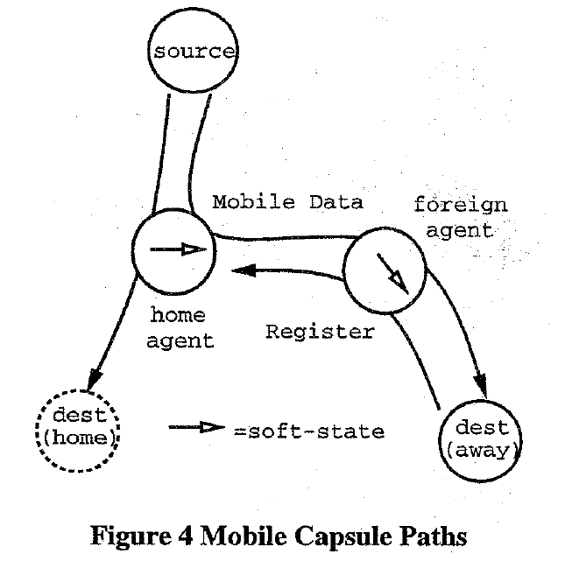
ANTS example – mobile host
Two cooperating capsule types
Register capsule
Mobile hosts that are roaming periodically send
Register capsules to their home agent by its foreign
Agent
Mobile data capsule
Sent by other hosts that communicate with the
mobile host
Make use of the forwarding information
Notes:
Home agent: local router

Slide 10
Contributions and limitations
Contributions
Programmable functions will lower the barrier to innovation
Network virtualization and the ability to demultiplex to software programs based on packet headers
Shared resource
The vision of a unified architecture for middlebox orchestration
Limitations
Performance
Security
lack of an immediately compelling problem or a clear path to deploy

Slide 11
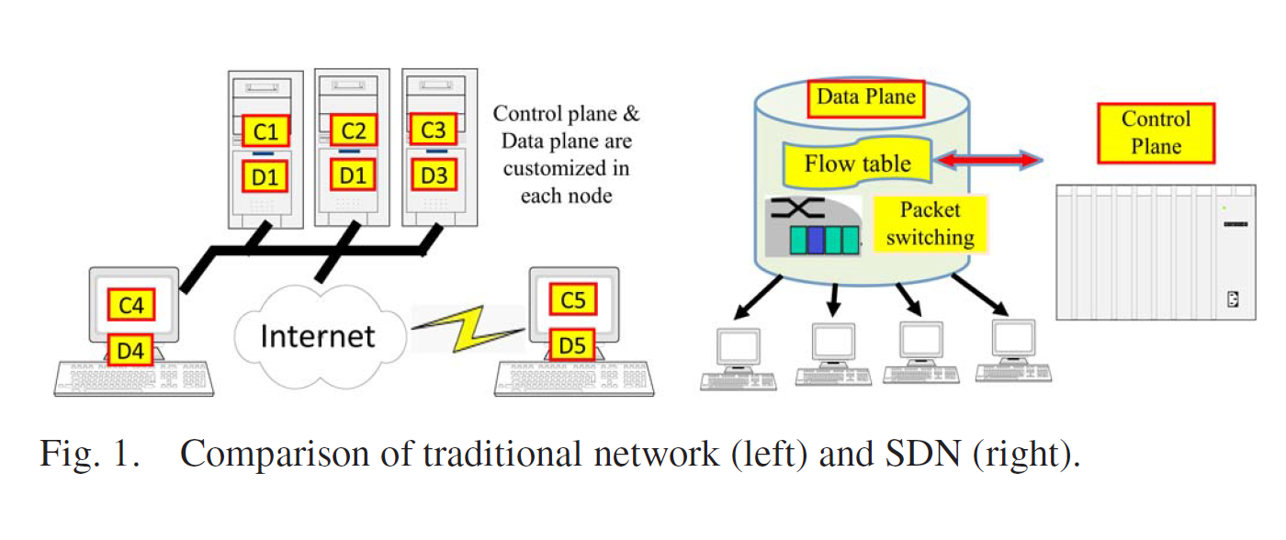
Separating Control and Data Planes
Conventional routers and switches embody a tight integration between the control and data planes^{[1]}
[1] Hu, Fei, Qi Hao, and Ke Bao. "A survey on software-defined network and openflow: From concept to implementation." IEEE Communications Surveys & Tutorials 16, no. 4 (2014): 2181-2206.

Slide 12
Separating Control and Data Planes
New trends in 1990s
Link speeds in backbone networks grew rapidly, leading equipment vendors to implement packet-forwarding logic directly in hardware
ISPs were struggling to manage the increasing size and scope of their networks
Servers have substantially more memory and processing resources than the control plane processor of a router
Two innovations
An open interface between the control and data planes
ForCES (Forwarding and Control Element Separation) interface^{[2]}
Netlink interface^{[3]}
Logically centralized control of the network
[2] L. Yang, R. Dantu, T. Anderson, and R. Gopal. Forwarding and Control Element Separation (ForCES) Framework. Internet Engineering Task Force, Apr. 2004. RFC 3746.
[3] J. Salim, H. Khosravi, A. Kleen, and A. Kuznetsov. Linux Netlink as an IP Services Protocol. Internet Engineering Task Force, July 2003. RFC 3549.

Slide 13
Separating Control and Data Planes
Research focus on network management
Innovation by and for network administrators
Programmability in the control plane
Network-wide visibility and control
Examples of research problems
Routing
Routing within a single ISP
Flexible routing control across multiple administrative domains
Moving control functionality off network equipment and into separate servers

Slide 14
Separating Control and Data Planes
Concepts that have been carried forward in SDN designs
Logically centralized control using an open interface to the data plane
Correct operation under failure
Distributed state management
Replication for single point of failure
Inconsistent state across replicas
Each controller instance could be responsible for a separate portion of the topology
Exchange routing information with each other
Researchers start explores clean-slate architectures for logically centralized control

Slide 15
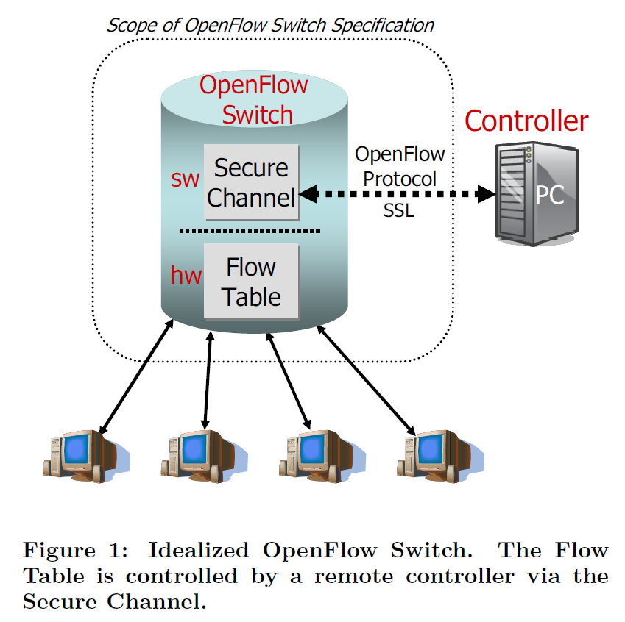
OpenFlow
Provide an open and standard way for a controller to communicate with a switch
McKeown, Nick, Tom Anderson, Hari Balakrishnan, Guru Parulkar, Larry Peterson, Jennifer Rexford, Scott Shenker, and Jonathan Turner. "OpenFlow: enabling innovation in campus networks." ACM SIGCOMM computer communication review 38, no. 2 (2008): 69-74.

Slide 16
Flow table abstraction
flow: defined by header field values (in link-, network-, transport-layer fields)
generalized forwarding: simple packet-handling rules
match: pattern values in packet header fields
actions: for matched packet: drop, forward, modify, matched packet or send matched packet to controller
priority: disambiguate overlapping patterns
counters: #bytes and #packets
Flow table
Router’s flow table define router’s match+action rules
match
action

Slide 17
Flow table abstraction
flow: defined by header fields
generalized forwarding: simple packet-handling rules
match: pattern values in packet header fields
actions: for matched packet: drop, forward, modify, matched packet or send matched packet to controller
priority: disambiguate overlapping patterns
counters: #bytes and #packets
src = *.*.*.*, dest=3.4.*.* forward(2)
Flow table
match
action
src=1.2.*.*, dest=*.*.*.* drop
src=10.1.2.3, dest=*.*.*.* send to controller
* : wildcard
1
4
3
2

Slide 18
OpenFlow: flow table entries
Match
Action
Stats
Packet + byte counters
Forward packet to port(s)
Drop packet
Modify fields in header(s)
Encapsulate and forward to controller
Header fields to match:
Ingress Port
Src MAC
Dst MAC
Eth Type
VLAN
ID
VLAN
Pri
IP Src
IP Dst
IP Proto
IP
ToS
TCP/UDP Src Port
TCP/UDP Dst Port
Link layer
Network layer
Transport layer

Slide 19
OpenFlow: examples
Destination-based forwarding:
Switch
Port
MAC
src
MAC
dst
Eth
type
VLAN
ID
VLAN
Pri
IP
Src
IP
Dst
IP
Prot
IP
ToS
TCP
s-port
TCP
d-port
Action
*
*
*
*
*
*
*
51.6.0.8
*
*
*
*
port6
IP datagrams destined to IP address 51.6.0.8 should be forwarded to router output port 6
Firewall:
Switch
Port
MAC
src
MAC
dst
Eth
type
VLAN
ID
VLAN
Pri
IP
Src
IP
Dst
IP
Prot
IP
ToS
TCP
s-port
TCP
d-port
Action
*
*
*
*
*
*
*
*
*
*
*
22
drop
Block (do not forward) all datagrams destined to TCP port 22 (ssh port #)
Switch
Port
MAC
src
MAC
dst
Eth
type
VLAN
ID
VLAN
Pri
IP
Src
IP
Dst
IP
Prot
IP
ToS
TCP
s-port
TCP
d-port
Action
*
*
*
*
*
*
128.119.1.1
*
*
*
*
*
drop
Block (do not forward) all datagrams sent by host 128.119.1.1

Slide 20
OpenFlow: examples
Layer 2 destination-based forwarding:
Switch
Port
MAC
src
MAC
dst
Eth
type
VLAN
ID
VLAN
Pri
IP
Src
IP
Dst
IP
Prot
IP
ToS
TCP
s-port
TCP
d-port
Action
*
*
22:A7:23:
11:E1:02
*
*
*
*
*
*
*
*
*
port3
layer 2 frames with destination MAC address 22:A7:23:11:E1:02 should be forwarded to output port 3

Slide 21
OpenFlow abstraction
match+action: abstraction unifies different kinds of devices
Router
match: longest destination IP prefix
action: forward out a link
Switch
match: destination MAC address
action: forward or flood
Firewall
match: IP addresses and TCP/UDP port numbers
action: permit or deny
NAT
match: IP address and port
action: rewrite address and port

Slide 22


OpenFlow example
Orchestrated tables can create network-wide behavior, e.g.,:
datagrams from hosts h5 and h6 should be sent to h3 or h4, via s1 and from there to s2
Host h6
10.3.0.6
1
s3
controller
2
3
4
Host h5
10.3.0.5
1
s1
s2
Host h1
10.1.0.1
1
2
Host h4
10.2.0.4
4
2
4
3
3
Host h2
10.1.0.2
Host h3
10.2.0.3

Slide 23
OpenFlow example
match
action
Orchestrated tables can create network-wide behavior, e.g.,:
datagrams from hosts h5 and h6 should be sent to h3 or h4, via s1 and from there to s2
IP Src = 10.3.*.*
IP Dst = 10.2.*.*
Host h6
10.3.0.6
forward(3)
1
s3
controller
2
3
4
Host h5
10.3.0.5
1
s1
s2
Host h1
10.1.0.1
1
2
Host h4
10.2.0.4
4
2
4
3
3
match
action
match
action
Host h2
10.1.0.2
Host h3
10.2.0.3
ingress port = 2
IP Dst = 10.2.0.3
ingress port = 2
IP Dst = 10.2.0.4
ingress port = 1
IP Src = 10.3.*.*
IP Dst = 10.2.*.*
forward(3)
forward(4)
forward(4)

Slide 24
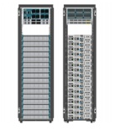
SDN controllers
App
App
App
App
App
App
App
App
App
App
App
Network elements has two components: OpenFlow client, forwarding hardware with flow tables.
The SDN controller must implement the network OS functionality
Provide abstraction to the upper layer
Provide control to the underlying hardware
Managing the resources
Northbound Interface
SDN controller
OpenFlow

Slide 25
SDN controllers (NOS) .vs. OS
OS
Network OS
Resources managed
CPU, memory, disk, IO devices, etc
Applications:
User programs that use the resources
OS functionality (abstraction):
CPU virtualization
Memory virtualization
IO virtualization
File systems
Resources managed
Connected switches/routers/NICs
Applications
Firewall, migration, network virtualization, NAT, TE, etc
NOS functionality?
Network abstraction – this is a new thing that is not well understood.

Slide 26
NOS functionality
From: “NOX: towards an Operating System to Networks”
NOS should present application programs with a centralized programming model
Programs should be written in terms of high-level abstractions, not low-level parameters

Slide 27
Existing SDN controllers
NOX/POX
Ryu
Floodlight
Pyretic
Frenetic
Open Daylight
ONOS
And many more
Some artificial differences: language
More important differences:
API
Functionality

Slide 28
SDN controller: NOX/POX
NoX is the first OpenFlow controller
NOX: C++ version; POX: python version
POX comes with Mininet – the simulation infrastructure
OpenFlow v.1.0
Programming model:
Controller registers for events (PacketIn, ConnectionUP, etc).
Programmer write event handler
NOS does little for the applications

Slide 29
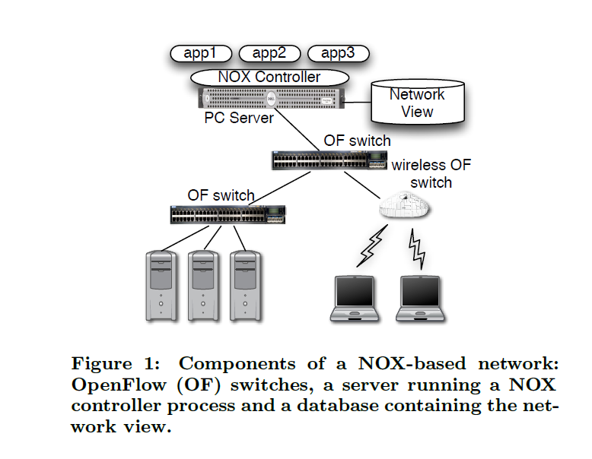
SDN controller: NOX/POX
NOX’s network view:
1. the switch-level topology;
2. the locations of users, hosts, middleboxes, and
other network elements;
3. the services (e.g., HTTP or NFS) being offered

Slide 30
NOX/POX component
NOX/POX controller
Connection
Manager
Event
dispatcher
OpenFlow
Manager
DSO
Deployer
Input/output Socket
Asynchronous File
OpenFlow
API
Threading and event
management
Other
utilities
Notes:
dynamic shared object

Slide 31
NOX/POX Events
FlowRemoved
ConnectionUP
PacketIn
etc
User write event handlers
E.g. ConnectionUp: record in the database, PacketIn: compute the route, setup flow table along the path, etc
Abstraction? Global view build from control program, fairly low level.
https://noxrepo.github.io/pox-doc/html/
Notes:
establishment of a new control channel with a switch

Slide 32
ONOS
Open Network Operating System (ONOS) is the leading open source SDN controller for building next-generation SDN/NFV solutions

Slide 33
ONOS
Production ready SDN controller
Distributed core for high availability
Modular, Clean and extensible architecture
High Performance
Scalability of the cluster
Extensive suite of applications that can suit your need
Easy to use through CLI, GUI and REST API
Drivers and protocol Subsystem to support different devices and makers
Control of networks made of heterogeneous devices
Simplifies network control and management
Open source
Great community

Slide 34
ONOS further reading
ONOS website:
http://onosproject.org
Tutorials, documentation and general reading at:
https://wiki.onosproject.org/
ONOS is on Github at:
https://github.com/opennetworkinglab/onos
Setup Tutorial
https://wiki.onosproject.org/display/ONOS/Installing+and+Running+ONOS
Screencasts:
https://wiki.onosproject.org/display/ONOS/Screencasts

Slide 35
Overview of the ONOS architecture
By Thomas Vachuska (lead developer of ONOS)

Slide 36
Next Lecture
Introduction to Mininet and OpenVSwitch

